Slide 1
Responsive Positioning
Front-End Web Development

Slide 2
Lesson 08 Change Log FEWD 3.1–3.2
Below are the specific changes made in this lesson.
Returning Instructor Directions:
Click on the hyperlinks below, and it will direct you to the specific slide.
Copy the entire slide, and paste in your existing curriculum deck.
Pre-Class Materials and Preparation - Added one new CodePen — Relative vs. Absolute Positioning — to Reference Code.
Share how the lesson went through our Instructor Lesson Exit Ticket - the Curriculum Feedback form: http://ga.co/curriculum-feedback

Slide 3
Pre-Class Materials and Preparation
Review all slides, lab activities, and code-alongs.
There are prompts in the speaker notes with opportunities for instructor customization.
Materials:
Reference Code
Starter Code in CodePen
Solution Code in CodePen

Slide 4
Responsive Positioning
Overview
This lesson covers the use of the position property.
Learning Objectives
In this lesson, students will:
Use the position property to create responsive layouts.
Define and choose between absolute, relative, static, and fixed positioning.
Duration: 180 minutes

Slide 5
Suggested Agenda
Time | Activity | Purpose
0:00–0:45 | Relative, Absolute, and Fixed Position | Introduce alternate uses of the position property.
0:45–1:15 | Position Walk-Through | Demonstrate the use of the position properties.
1:15–1:45 | Positioning Exercise | Introduce the concept of UI components.
1:45–2:15 | Drop Down Menu/Modal Examples | Demonstrate how these properties can be used to create interactive components.
2:15–3:00 | Adding a Modal to Previous Homework | Set up this week's homework, giving students time to work on it and ask questions as they get stuck.

Slide 6
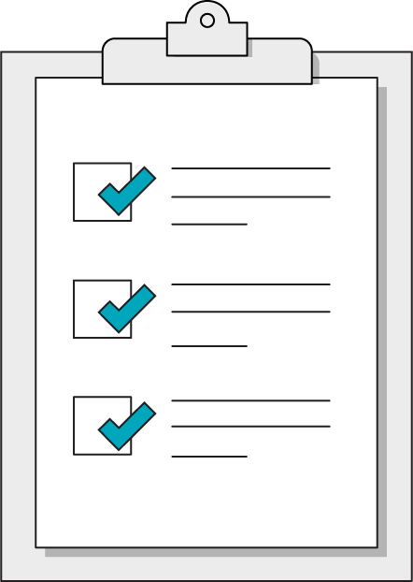
Today’s Learning Objectives
In this lesson, you will:
Use the position property to create responsive layouts.
Define and choose between absolute, relative, static, and fixed positioning.
‹#› | © 2020 General Assembly
Notes:
DURATION: 1 minute
TEACHING TIPS:
Learning objectives help frame the lesson and give students an idea of what to expect and focus on.
Explain to students how this lesson fits into the overall course to help them make connections with content from other lessons.

Slide 7
The position Property
Front-End Web Development

Slide 8
position
When you position an HTML element on a webpage, you get plenty of properties by default:
// All block elements get these properties by default
.every-element {
display: block;
position: static;
width: 100%
}
Notes:
TALKING POINTS:
We’ve talked at about width and display quite a bit, but not position.
TEACHING TIPS:
Show them this in DevTools. Create a div in CodePen. On the “Computed” tab click “Show all” and scroll down to “position.”

Slide 9
Default HTML Behavior
Basic HTML element code...
Produces this output...
<main>
<section>Thing</section>
<div>Thing</div>
<nav>Nav Things</nav>
</main>
Thing
Thing
Nav Things

Slide 10
Why?
Each element takes 100% width, and its height is determined by the content between the tags. The next element positions itself directly after the one before it, so you get this pattern.
<section>
Thing
<div>
Thing
<nav>
Nav Things

Slide 11
The Big Idea
Locked 2D Layouts
3D Layouts
position:static;
These have a height and width and lay flat on the page in a specific position in the flow of the document.
position:relative; position:fixed; position:absolute;
These can be placed on top of or beneath other elements and take positions that ignore other elements.

Slide 12
Examples of position
Follow along with specific examples of the position property in this CodePen:
Reference code:
https://codepen.io/GAmarketing/pen/MWWZzBy

Slide 13
Relative Position
Front-End Web Development

Slide 14
Relative Position
.custom-element {
display: block;
position: relative;
width: 100%;
}
<main>
<section>Thing</section>
<div>Thing</div>
<nav>Nav Things</nav>
</main>
Notes:
TALKING POINTS:
How will this change the layout of our page?
It’s a trick question — you need other properties in place for it to do anything!

Slide 15
What Does Relative Position Actually Do?
position: relative; does not have any VISIBLE effects — at first.
.custom-element {
display: block;
position: relative;
width: 100%;
}
<main>
<section>Thing</section>
<div>Thing</div>
<nav>Nav Things</nav>
</main>
<section>
Thing
<div>
Thing
<nav>
Nav Things

Slide 16
Relative Position Pops the Element Up to Another Plane
A relative element hovers “above” the rest of the elements.
This will only be noticeable once we start moving it using other properties.
You can now position the element relative to its original location!
The new position is based on the starting point of where it would normally go.
You can control the z axis of the element with z-index to stack elements “on top of” one another.
A positive z-index means “higher” than regular content; negative means “lower.”

Slide 17
How Can We Move Relative Elements?
Say hello to some new CSS properties:
.your-element {
top: 100px;
bottom: -5%;
left: 2em;
right: 0.7rem;
z-index: 1;
}

Slide 18
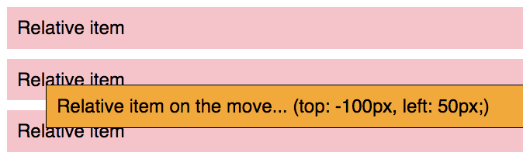
Moving Relative Elements
With top, right, bottom, and left, we can now move the element around the page relative to its original location.
.every-element {
position: relative;
top: -100px;
left: 50px;
}

Slide 19
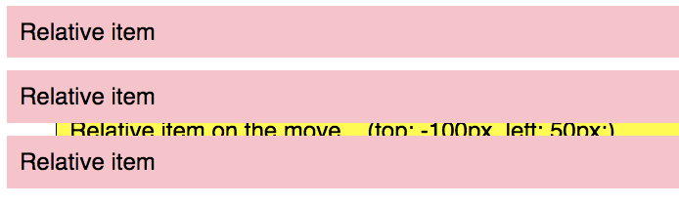
Movement on the Z Axis
But you can easily put it behind the other elements with z-index.
.every-element {
position: relative;
top: -100px;
left: 50px;
z-index: -1;
}

Slide 20
Use Cases for Z-Index
Now that we know how to elevate elements above others, let's think about why we would want to.
What website components can you think of that would make use of the ability to overlay elements?

Slide 21
Absolute Position
Front-End Web Development

Slide 22
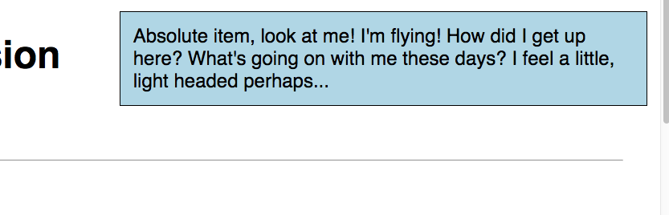
Absolute Position
When you give an element position:absolute, it moves on top of other elements relative to the entire page or its nearest non-static parent.
An absolute element can also be moved above/below other elements with z-index. By default, absolute elements sit on top of other elements.
.your-element {
position: absolute;
top: 5px;
left: 900px;
}
Notes:
TALKING POINTS:
position: relative removes the element from the normal document flow and the element positions itself to the top left-most corner of the document. This is because it’s default value will be top: 0 and left: 0.
TEACHING TIPS:
Move things around in the CodePen to show these in action.

Slide 23
When the Absolute Meets the Relative
You can also use absolute position for an element inside of a relatively positioned container.
An absolutely positioned element will be relative to its nearest non-static parent.
I’m absolute but something is holding me back. It’s tough being in a box.

Slide 24
Absolute in Relative
.relative-container {
height: 400px;
position: relative;
width: 400px;
}
/* The 25px top and 89px left is from */
/* The edge of the .relative-container */
.absolute-item-trapped {
height: 200px;
left: 89px;
position: absolute;
top: 25px;
width: 200px;
}
I’m absolute but something is holding me back. It’s tough being in a box.
Notes:
TALKING POINTS:
When an element has been assigned position: absolute, it seeks out the closest parent element in its hierarchy that is assigned position: relative. If it finds one, it uses that element to determine it’s left, right, top, and bottom coordinates, otherwise it uses the html element as it’s reference point.

Slide 25
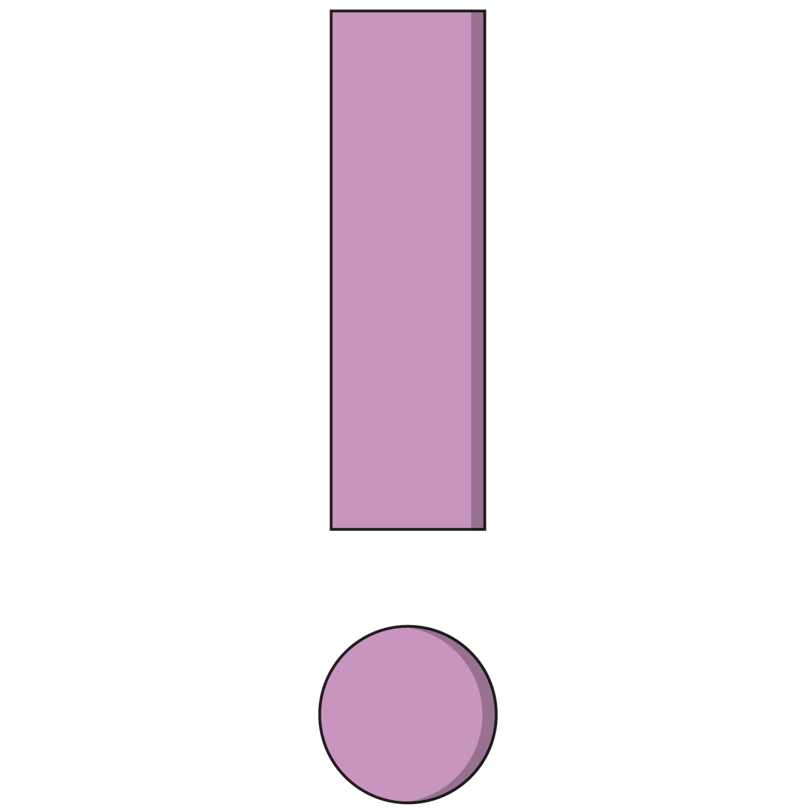
Watch Out for z-index!
Be careful with z-index:
It should only be used in very targeted ways.
Once you adjust it, there is a strong tendency to keep adjusting other elements as your site gets more complicated.
If you have more than 2–3 z-indexed items, you are doing it wrong.

Slide 26
Fixed Position
Front-End Web Development

Slide 27
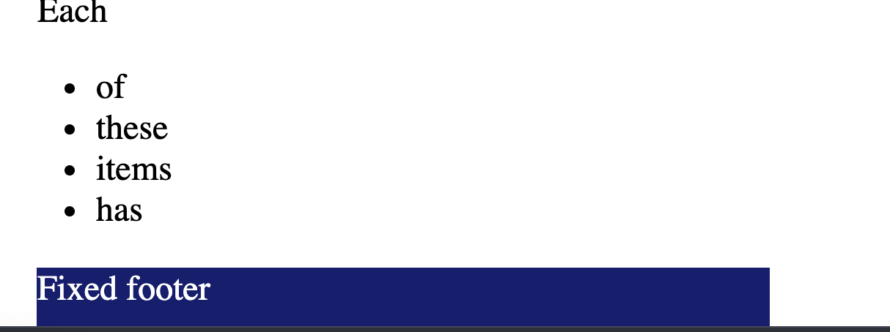
Position: Fixed
fixed positions are straightforward in comparison — fixed elements dock relative to the viewport wherever you put them, with 0 being the respective edge of the viewport.

Slide 28
Examples of Position
Let’s try some of these properties out and see what they do!
Reference code:
https://codepen.io/GAmarketing/pen/bGGOzGR
‹#› | © 2020 General Assembly
Notes:
TEACHING TIPS:
This is a super-loose starting place for this code-along. It’s an absolutely positioned box inside a relative container. You could go anywhere from here. Just showcase the properties we talked about and extend this idea. You want to be hinting at things that move — modals, menus, etc. JS is around the corner, so get the class to want to move stuff.
Here’s an alternative to the CodePen above: https://codepen.io/jkeohan/pen/pYodYx

Slide 29
Common Mistake No. 1
Solution
z-index Does Nothing!
z-index Needs a Friend
"I put z-index: 1000 on my element and nothing happened. Isn’t it supposed to jump out on top of everything?”
"I bet you didn't put position: relative; on it. If it’s still static, it can’t go anywhere. And what about a semicolon at the end?”
Notes:
TEACHING TIPS:
This slide comes in as two parts, so let the question stay up for a bit and solicit answers before clicking again to the solution part of the slide. The next slide is in the same format, so repeat the process.

Slide 30
Common Mistake No. 2
Solution
Absolute Is Absolute Chaos!
Non-Static Parent to the Rescue!
"I put a position: absolute; on my element, and it went to the top of the screen. Why didn’t it just go to the top of the container element like I wanted?"
“Because life is hard! But also, I bet you didn't put a position: relative; container around it. If the container is still static, the absolute position uses the entire document for its reference point.”

Slide 31
Positioning
30 minutes
Now, try out some of the positioning tools you’ve learned:
Starter code:
https://codepen.io/GAmarketing/pen/Baavbeg
Solution code:
https://codepen.io/GAmarketing/pen/pooqBJE
‹#› | © 2020 General Assembly
Notes:
TEACHING TIPS:
Hopefully, this should be a pretty easy exercise. Coming out of this a lot of students will say, “OK I get it, why are we doing this?” This is a leading exercise that’s designed to get them asking that question. Because it’s the tip of a large iceberg….
This is when you introduce components, things that move, and JS, if they can handle it. The next slides start doing that but your mileage may vary

Slide 32
Why Positioning?
Front-End Web Development

Slide 33

The Gateway to JavaScript
Once you grasp the position property, you may start to notice that the elements can move around the page freely, unconstrained by the rest of the elements.
JavaScript can use these properties for animations!
Notes:
TALKING POINTS:
Soon, we’ll learn to use JavaScript to add and remove these properties so elements can pop in and out of the page wherever and whenever we like! While we can currently use pseudo-selectors like :hover to replicate some JavaScript-esque actions, we’ll be able to respond to a lot more than just hovering once we start bringing JavaScript into the picture.

Slide 34

Think About an Off-Canvas Menu
Consider your viewport. Given what you now know about position and z-index, how would you approach getting a menu to appear and disappear?
Notes:
TEACHING TIPS:
Get them to think about how to move stuff off screen. How could you do it with position?

Slide 35
Off-Canvas Menu
z-index: lower
z-index: higher
Notes:
TEACHING TIPS:
The idea is for an absolute positioned element to be positioned off of the page and then to have it slide in over other content when the user clicks something. This, of course, is just one idea of how to do this. Remind students that there will be many ways to solve nearly anything in web development!

Slide 36
Dropdown Menu
We can also use these properties, combined with the hover pseudo-selector, to create dynamic dropdown menus!
Reference code:
https://codepen.io/GAmarketing/pen/RwwEOLz

Slide 37
Activating a Modal
This example demonstrates a modal — a common component that pops up above the rest of the content using position and z-index.
Reference code:
https://codepen.io/GAmarketing/pen/RwwEOjX
Notes:
TEACHING TIPS:
You can also show students how JavaScript/jQuery can be used in tandem with these properties to create animated components. Adding/removing classes with specific properties can add very powerful functionality to our components!

Slide 38
How Do You Make It Move?
Let's look at a preview of how we can use these properties:
Reference code:
https://codepen.io/GAmarketing/pen/NWWemdx
Notes:
TEACHING TIPS:
If you think your class is ready for it, this and the following slide have examples of combining JavaScript with these CSS properties to make dynamic components. Maybe you go big here and do a little JS with them. Maybe you just tease it. Either way, introduce JavaScript at a high level.

Slide 39
Not Just Sidebars...
Carousels:
https://codepen.io/GAmarketing/pen/gOOZyeb
Notes:
TEACHING TIPS:
You want students to see things and be impressed but understand that they know 80–90% of what’s going on here already. And we’re going to fill in the gaps. Impress and amaze, but don’t overwhelm with crazy examples.

Slide 40
Refactoring Homework
Front-End Web Development

Slide 41
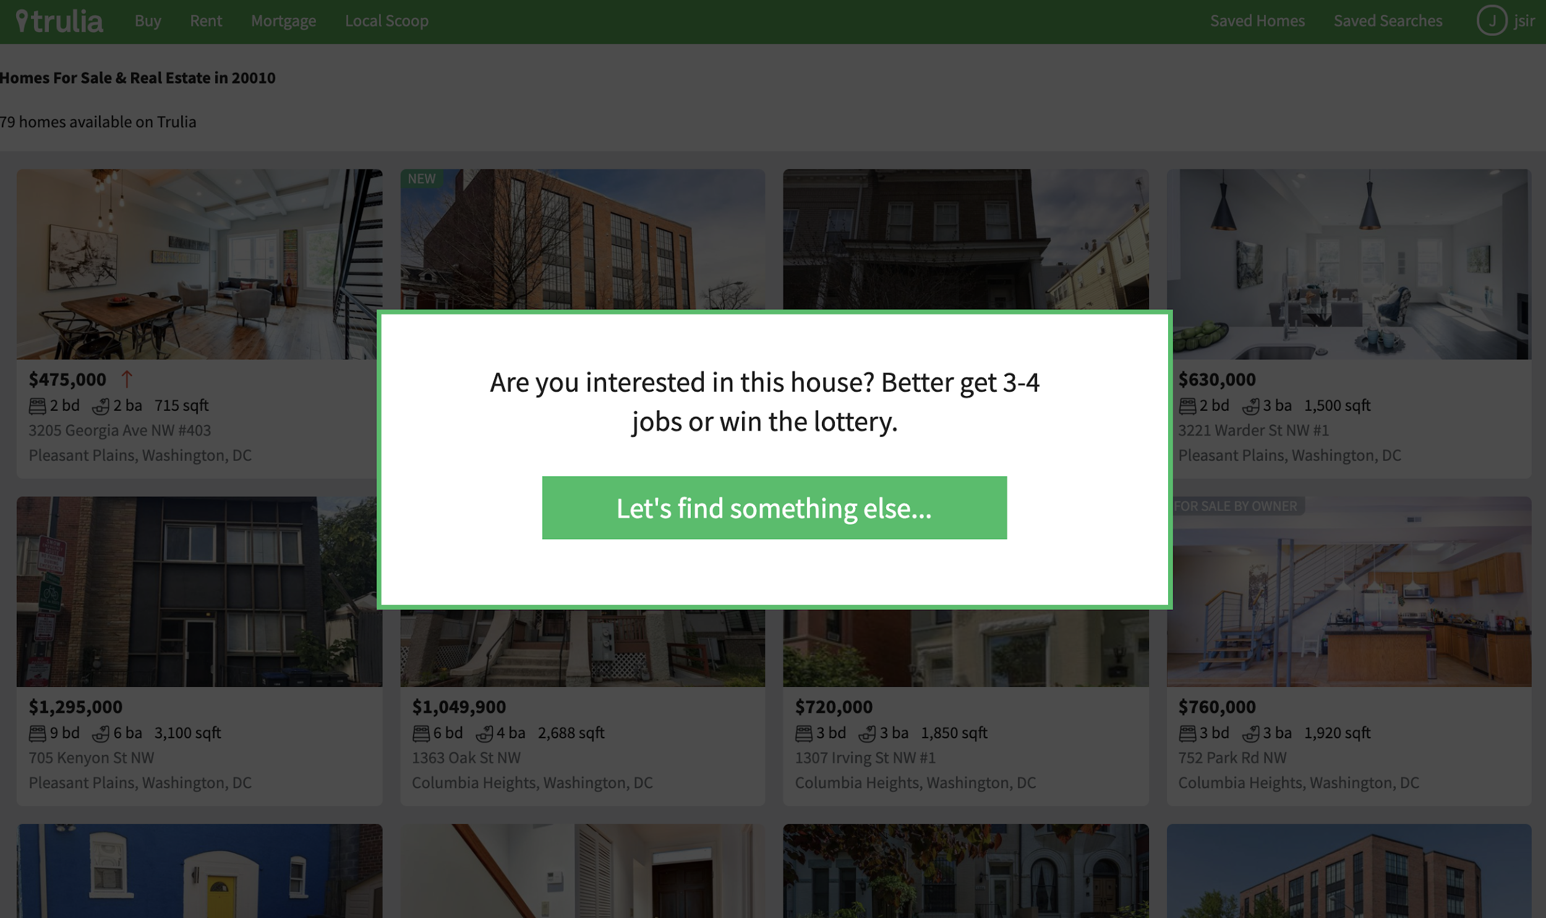
Add a Modal to Homework 3 for Homework 4
Homework 3 contained a nice grid and flexbox layout to really push you to the next level. Now it’s time to level up once again by adding your first component: a modal window.
Do some research and see how you would implement one.
Notes:
TEACHING TIPS:
You can challenge more advanced students to try to make the window appear and disappear with a click listener, but the goal is simply to have it show up on the page as pictured.

Slide 42
Key Takeaways
For Next Time
Positioning Moves Elements
Introduction to Programming
The position property can set elements’ places relative to the viewport or their original location.
Changing these properties with JavaScript can create dynamic, interactive components.
Complete Homework 4.
Begin planning your final project! Check the guidelines for more information.
We’ll start to think of our sites as interactive applications that remember and respond to user actions.
‹#› | © 2020 General Assembly

